Slide 1
Plotting in Python with Matplotlib
Chris Cooling
Graduate School Senior Teaching Fellow

Slide 2
Important Information on Marking your Attendance on Inkpath I will show you a QR code at the end of the session allowing you to mark your attendance on Inkpath. Please do not mark your attendance until then. If you are a Postgraduate Research student, this is required for receiving your Graduate School credit for this course.
Notes:
No additional notes.

Slide 3
Learning Outcomes
Understand how to use example codes to create high-quality figures for your publications and thesis
Create and export a variety of plots using matplotlib
Represent multiple data series efficiently on a single plot
Customise the appearance of plots and generate subplots in one figure

Slide 4
Course Materials
The course materials are stored in a GitHub repository
Instructions for using the materials are found in the readme
Links to open the course notebooks in Colab are at the bottom of the readme
The materials can also be downloaded and run locally
You can also star/fork the repository

Slide 5
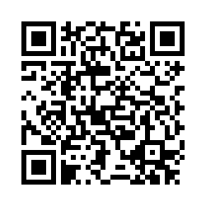
Feedback
Once you’ve completed this course, please provide feedback
The link is https://tinyurl.com/feedback-rcds
You should also have received an email with this link
This helps us improve the class for future students

Slide 6
Plotting in Python with Matplotlib
Distributed under Creative Commons Attribution-NonCommercial-ShareAlike 4.0 International

